Slide 1
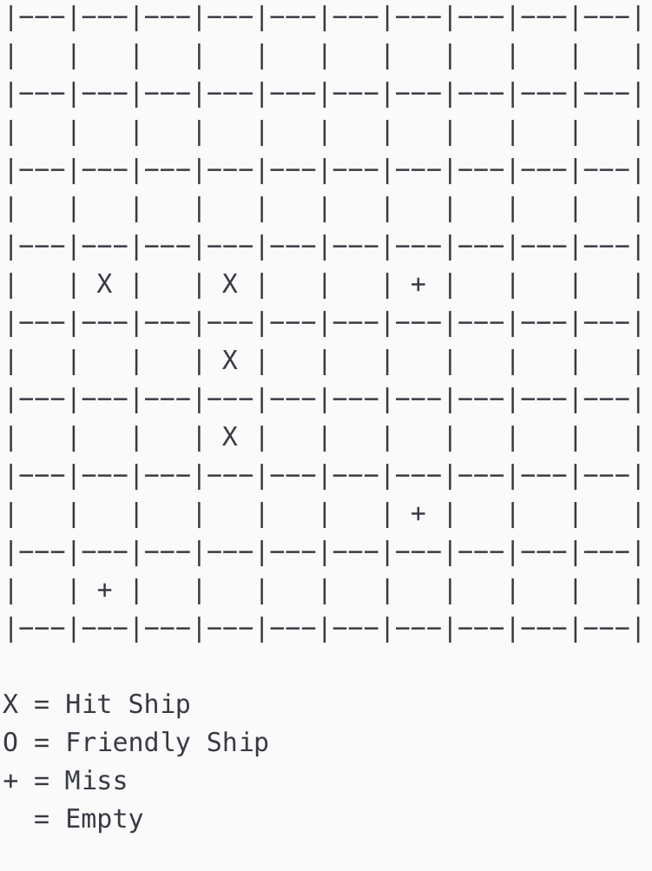

BATTLESHIPS
By Nathan, Caspian, and Tazkia

Slide 2
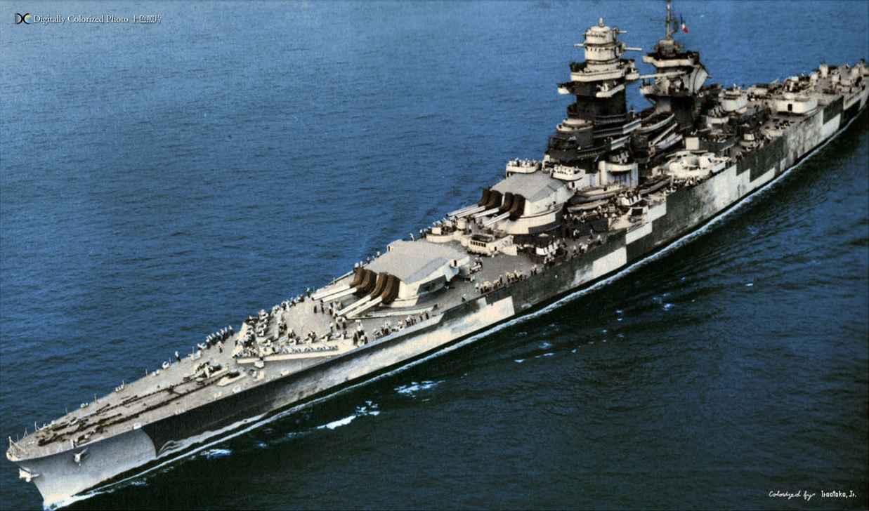
Players:
2 (Player VS AI)
Goal:
Sink all of your opponent’s ships
Setup:
Both Player and AI place their ships on the grid
Rules:
Player and AI take turn firing shots

Slide 3
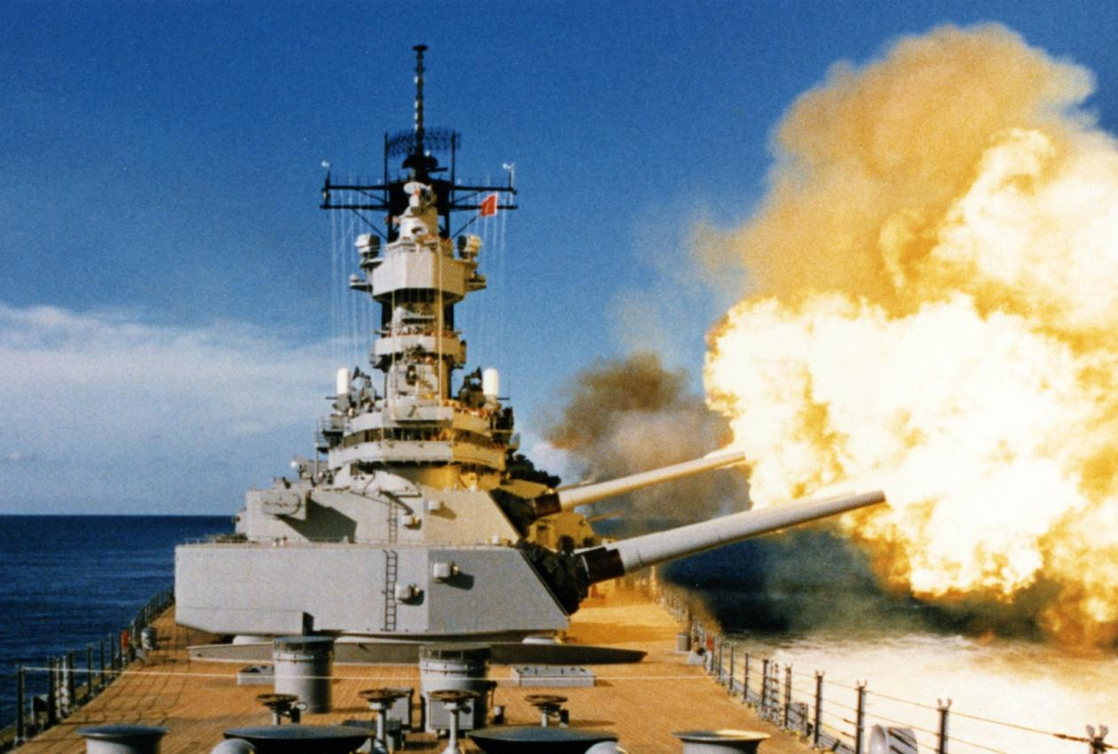
Why we chose this project
Utilizes Matrices
Utilizes methods for storing, updating, and interpreting data
Is time consuming

Slide 4
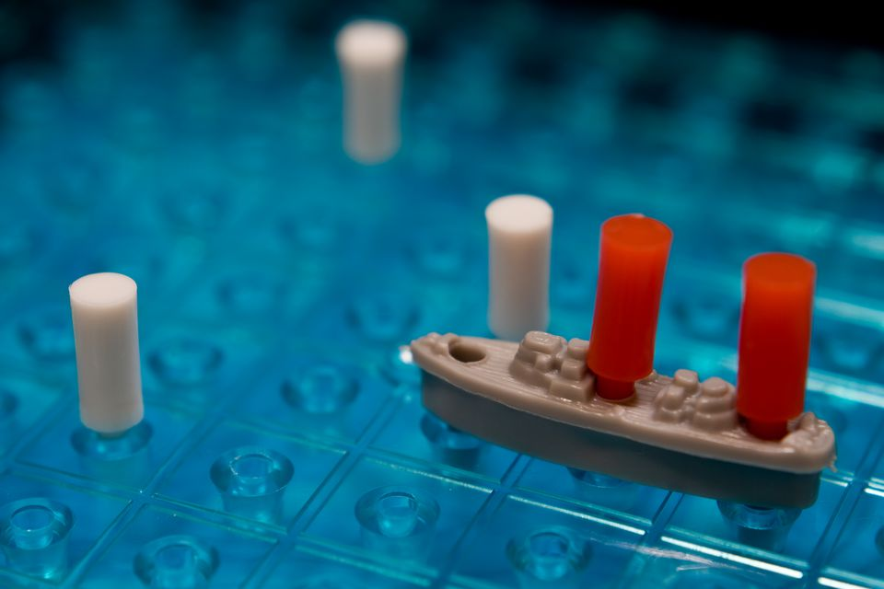
Foreseen Risks
Ship overlapping during placement
Smart AI shooting

